Slide 1
Web Application Development With Java CEJV 559
Version Control Basics

Slide 2
Version Control/Revision Control/Source Control
Lets you track your files over time
You’ve probably have your own version control system
ResumeOct2006.doc
ResumeMar2007.doc
Use “Save As”.
New file does not obliterate the old one.
Use a shared folder so other people can see and edit files
Hopefully they rename the file before they save it

Slide 3
Why Do We Need Version Control/Revision Control/Source Control
Backup and Restore.
Files are saved as they are edited
Jump to any moment in time
Synchronization.
Share files and stay up-to-date with the latest version.
Short-term undo.
Throw away your changes and go back to the “last known good” version in the database.

Slide 4
Why Do We Need Version Control/Revision Control/Source Control
Long-term undo.
Suppose you made a change a year ago, and it had a bug.
Jump back to the old version, and see what change was made that day.
Track Changes.
As files are updated, leave messages explaining why the change happened

Slide 5
Why Do We Need Version Control/Revision Control/Source Control
Track Ownership.
Every change tagged with the name of the person who made it.
Sandboxing.
Can make temporary changes in an isolated area, test and work out the kinks before “checking in” changes.
Branching and merging.
Branch a copy of your code into a separate area and modify it in isolation.

Slide 6
Basic Setup
Repository (repo)
The database storing the files.
Server
The computer storing the repo.
Client
The computer connecting to the repo.

Slide 7
Basic Setup
Working Set/Working Copy
Your local directory of files, where you make changes.
Trunk/Main
The primary location for code in the repo. Think of code as a family tree — the trunk is the main line.

Slide 8
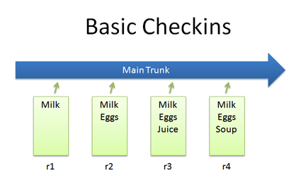
Checkins
Simplest scenario is checking in a file (list.txt) and modifying it over time.

Slide 9
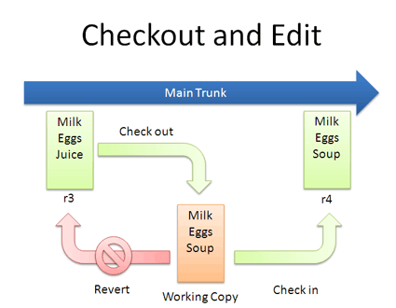
Checkout and Edit
You might not keep checking in a file.
You check out, edit and check in.

Slide 10
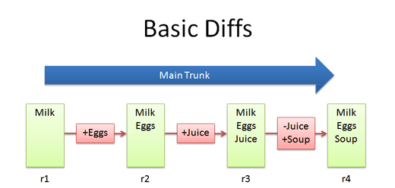
Diffs
Trunk has a history of changes as a file evolves.
Diffs are the changes you made while editing

Slide 11
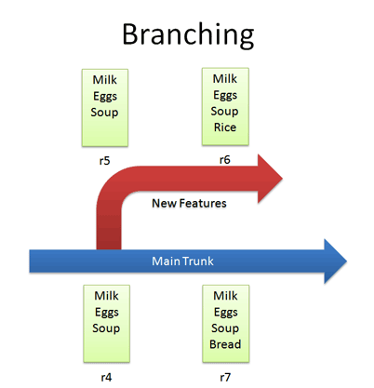
Branching
Branches let us copy code into a separate folder

Slide 12
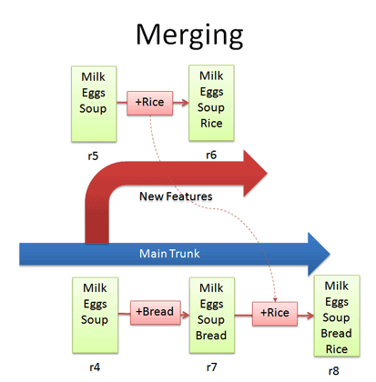
Merging

Slide 13
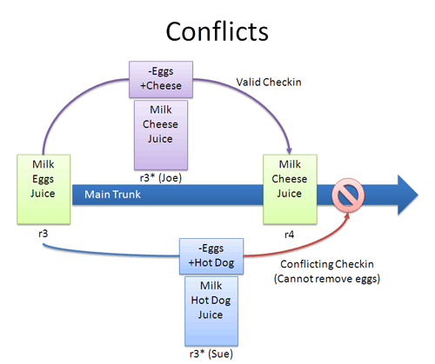
Conflicts
VCS can automatically merge changes to different parts of a file.
Conflicts can arise when changes appear that don’t gel

Slide 14
Conflicts
When changes overlap and contradict, the VCS reports a conflict and does not let you check in
You must check in a newer version that resolves this dilemma.
Re-apply your changes.
Sync to the latest version and re-apply your changes to this file:
Add hot dog to the list that already has cheese.

Slide 15
Conflicts
Override their changes with yours.
Check out the latest version, copy over your version, and check your version in.
Removes cheese and replaces it with hot dog.

Slide 16
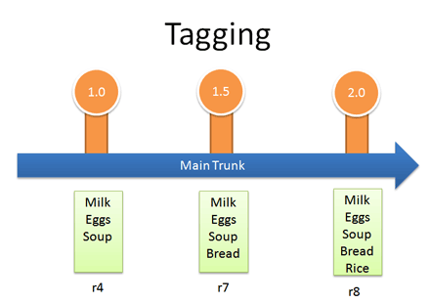
Tagging
Lets you tag (label) any revision for easy reference.
You can refer to “Release 1.0″ instead of a particular build number.

Slide 17
Bibliography
http://betterexplained.com/articles/a-visual-guide-to-version-control/

